Slide 1
Microsoft 365 Enterprise
License Map – July 2019
@AaronDinnage

Slide 2
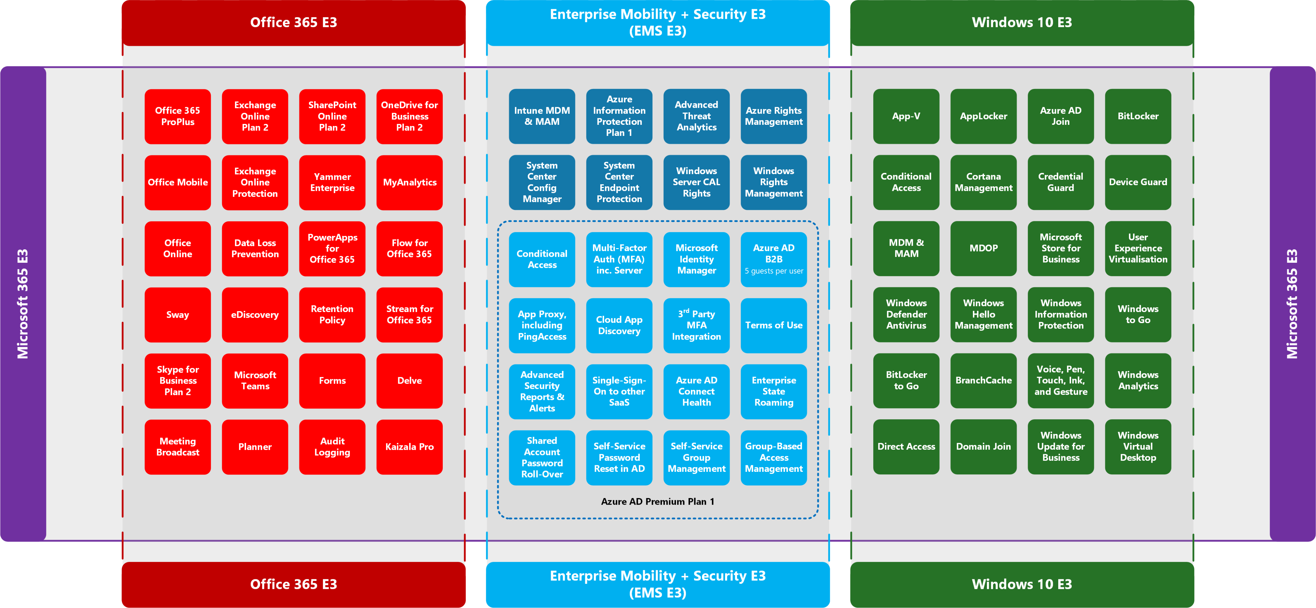
@AaronDinnage

Slide 3
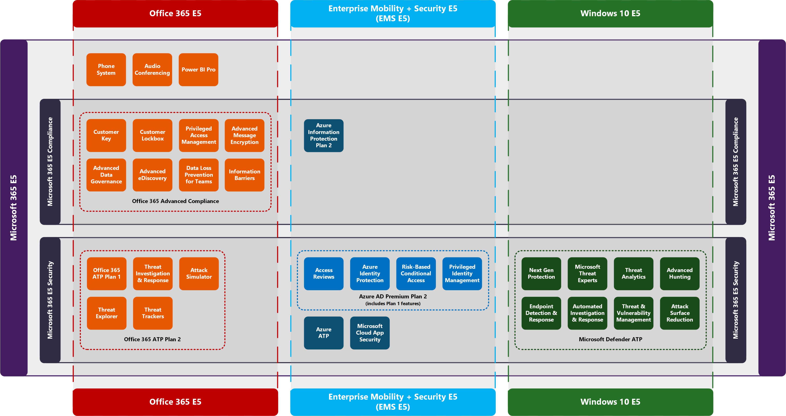
@AaronDinnage

Slide 4
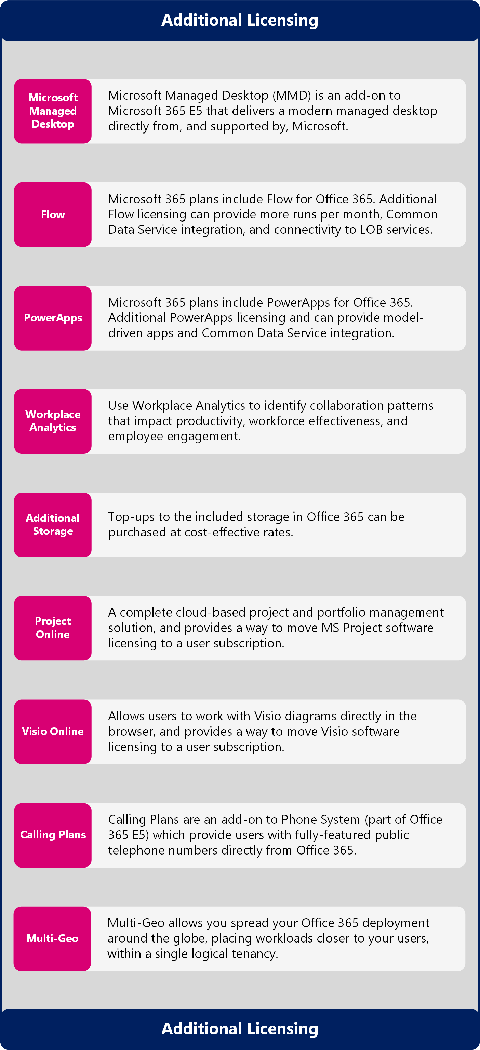
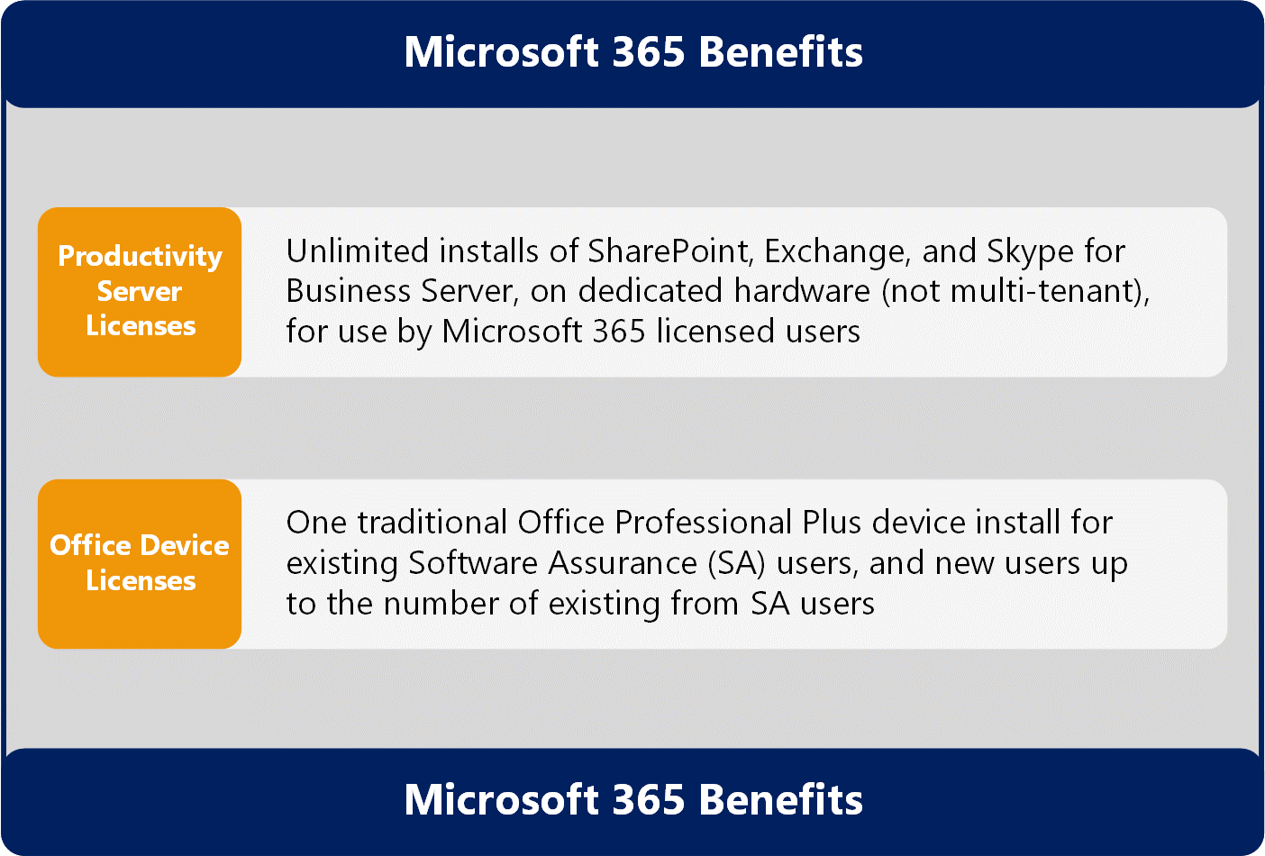
Microsoft 365 Benefits and Additional Licensing
https://github.com/AaronDinnage/Licensing

